Slide 1

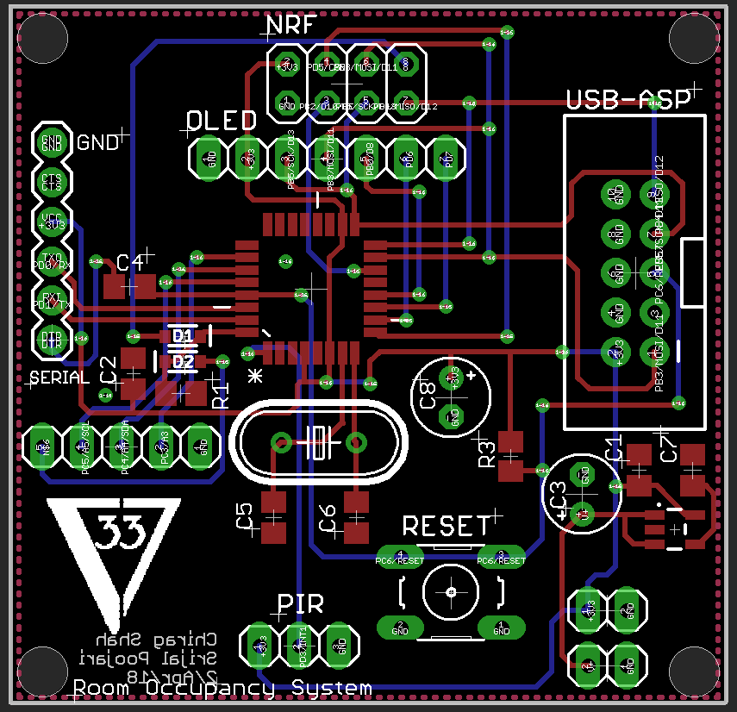
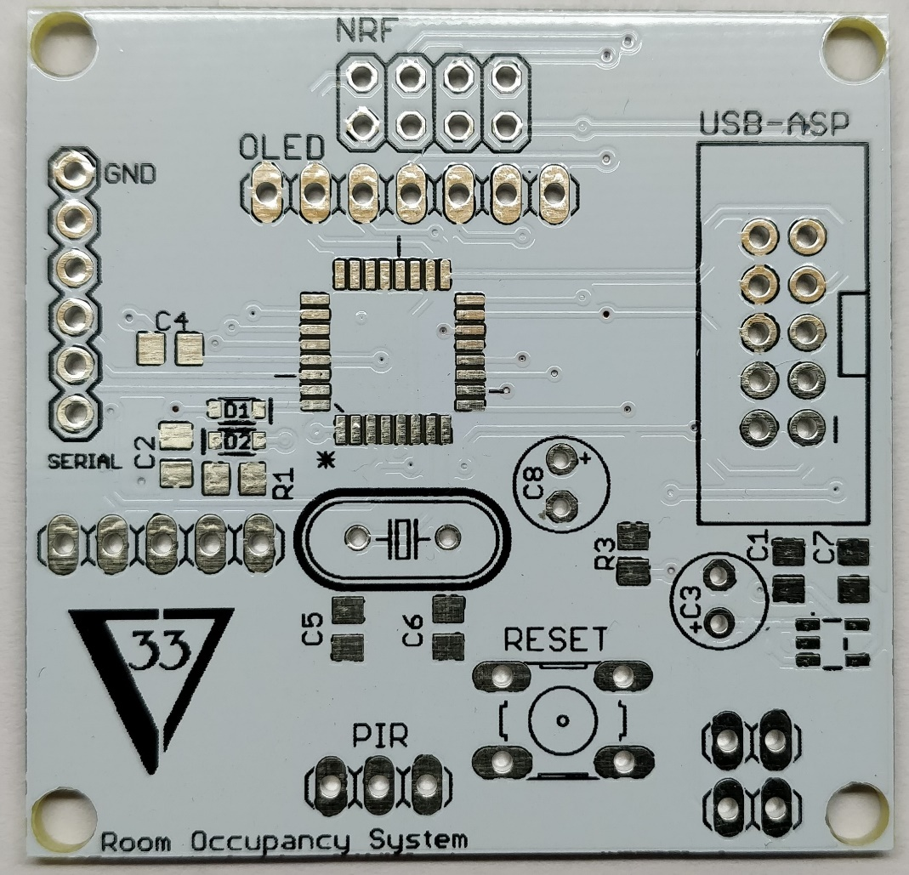
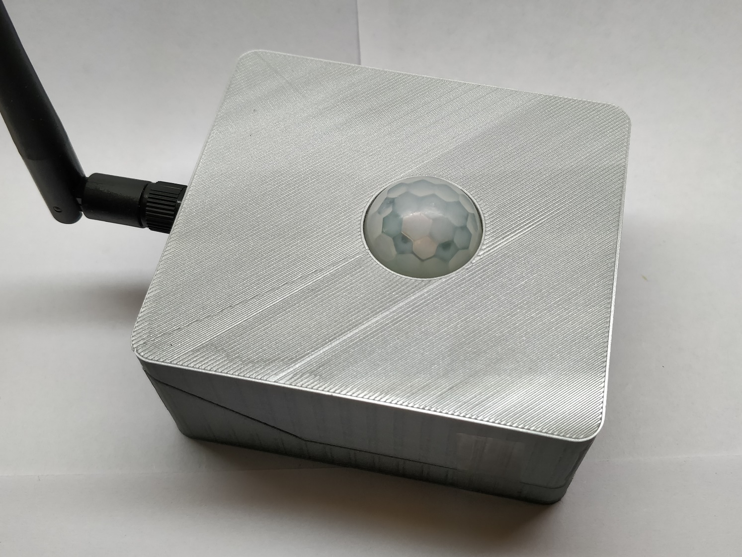
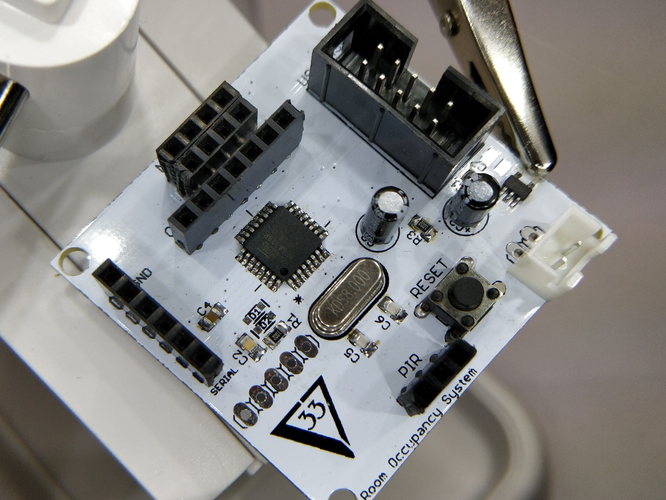
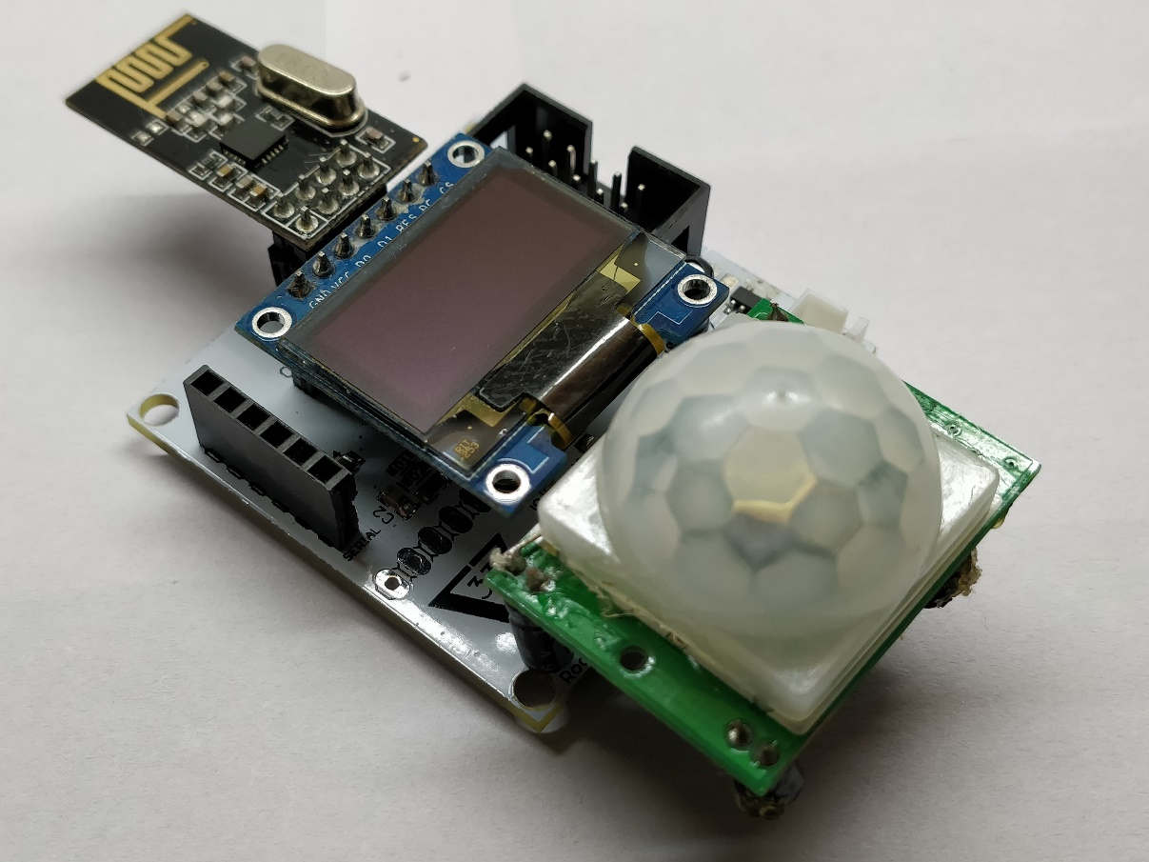
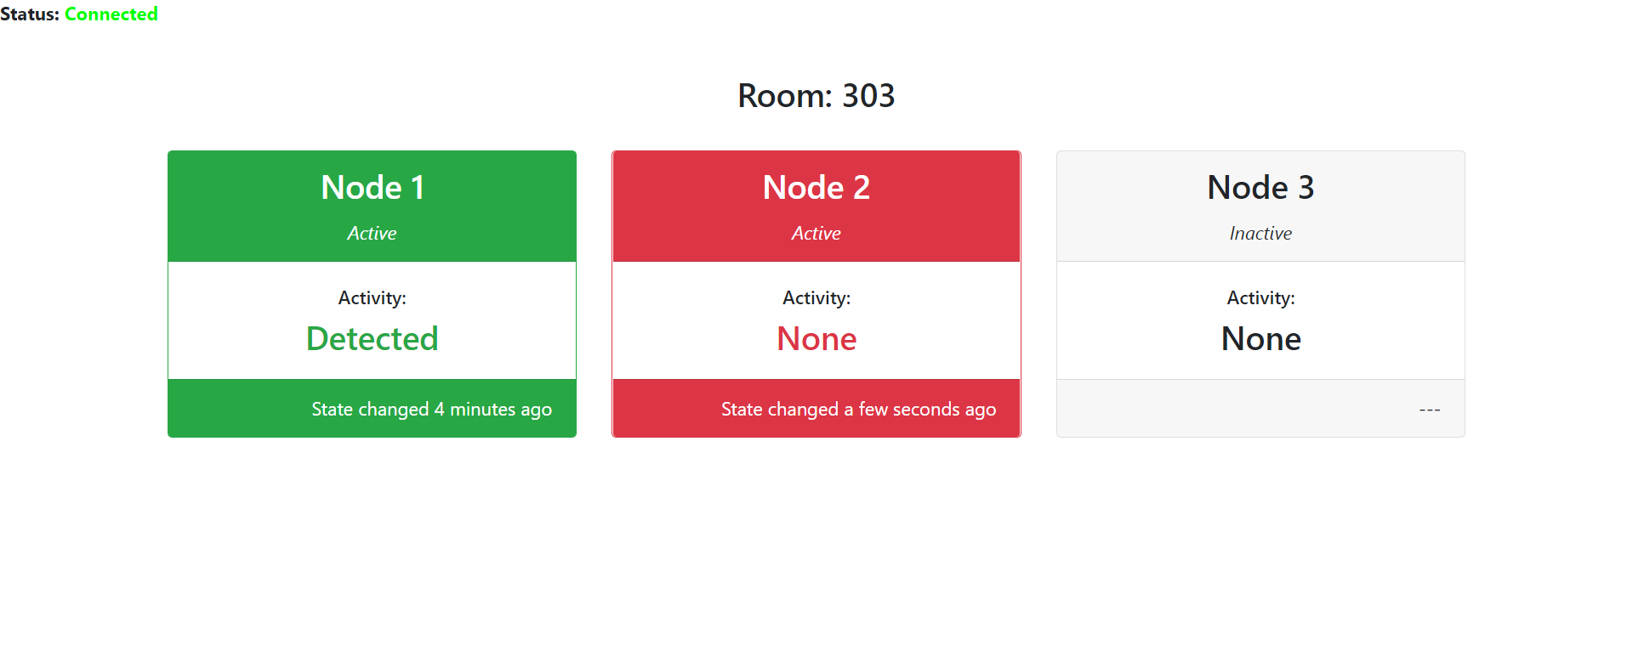
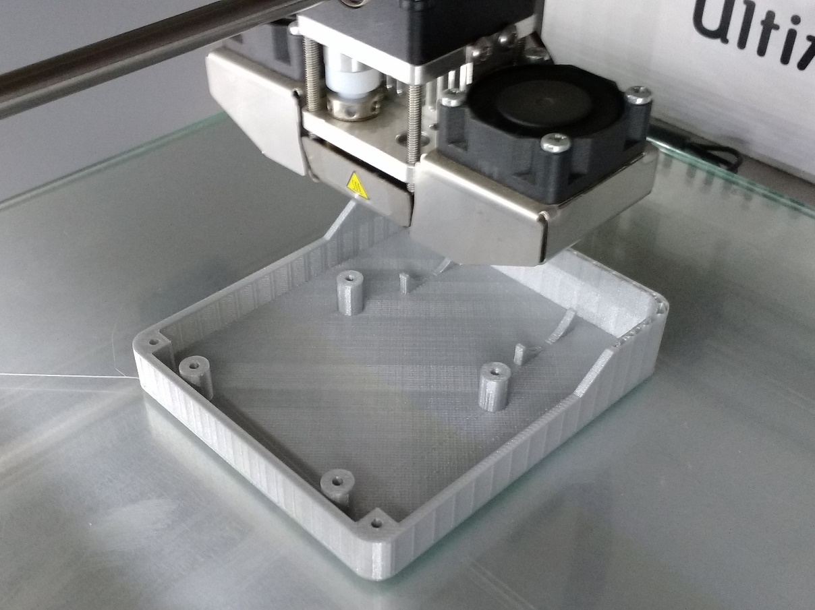
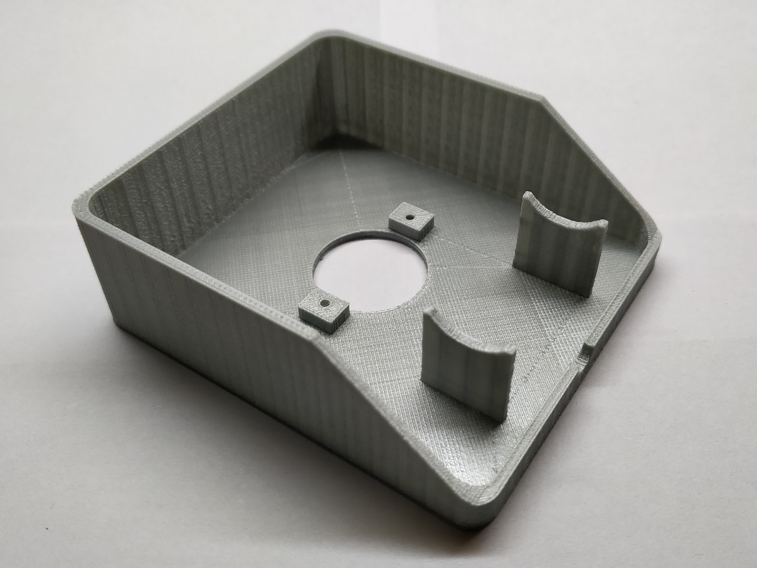
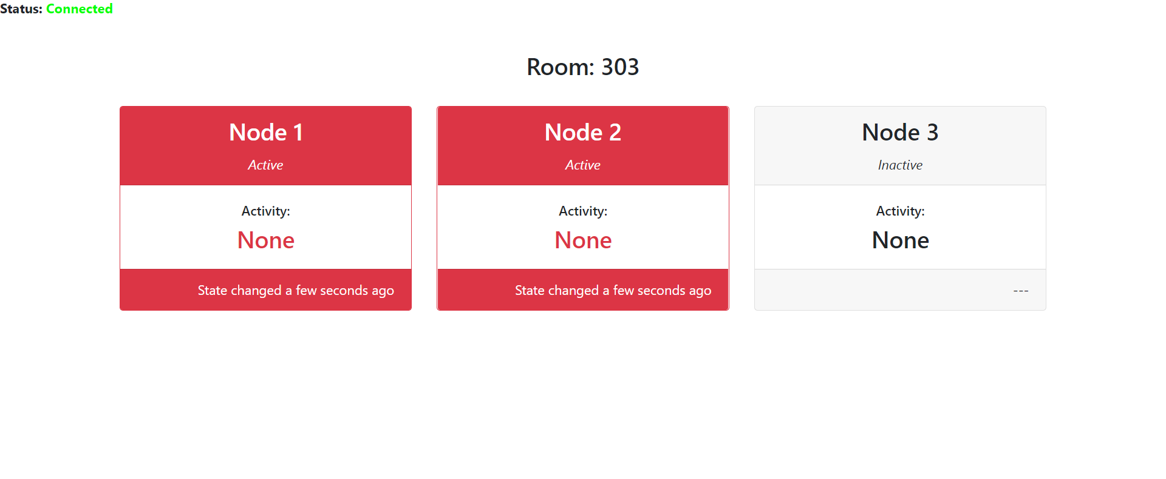
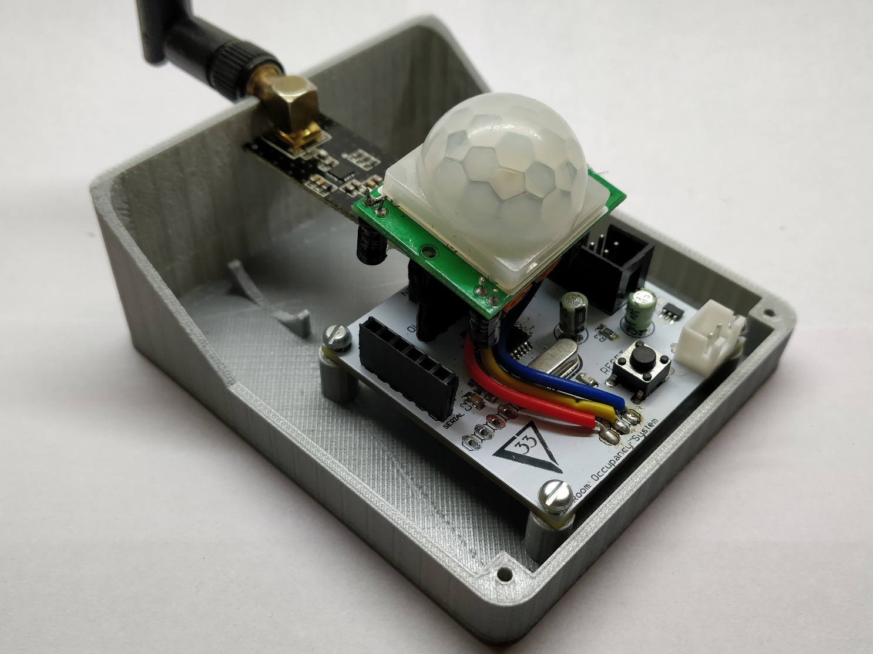
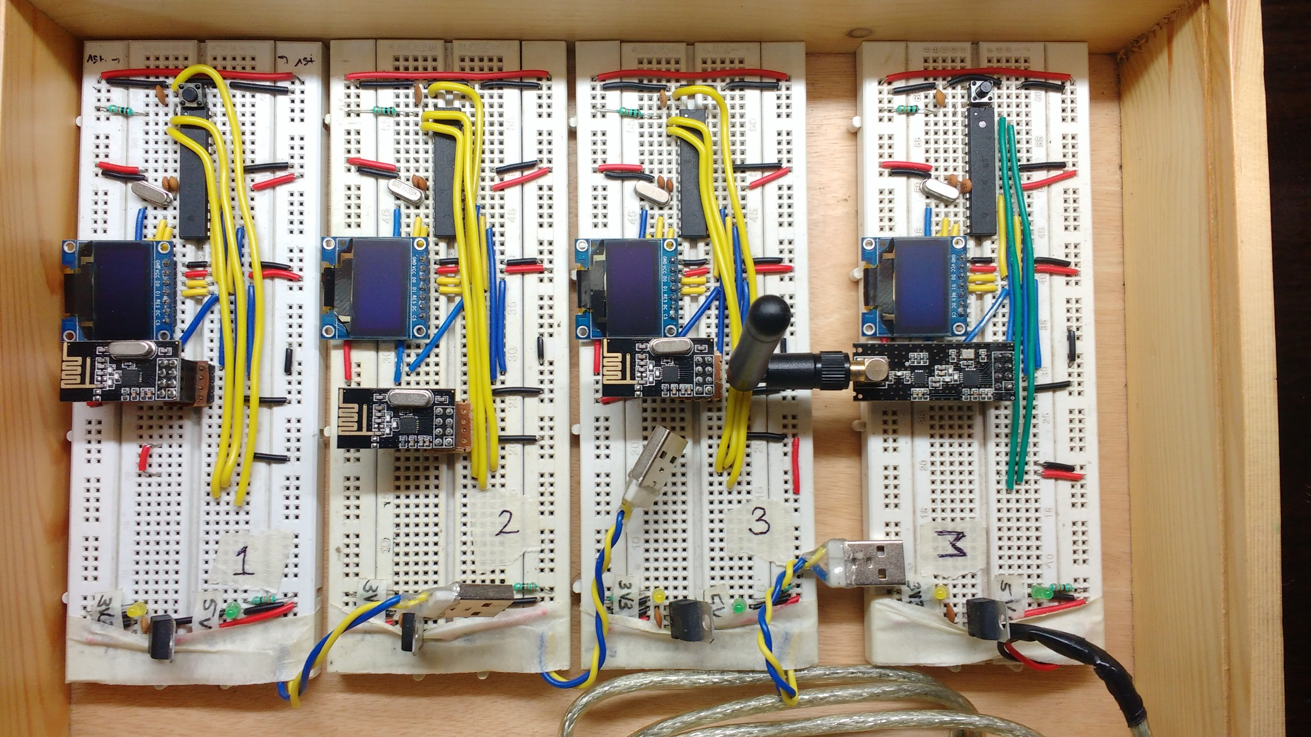
Low Cost Real-time Room
Occupancy Indicating System
Chirag Shah, Srijal Poojari Guide: Prof. Priya Deshpande
Department of Electronics Engineering, Sardar Patel Institute of Technology, Andheri (West), Mumbai-400058
Introduction
Designed the PCB of the circuit in Eagle and got it manufactured from a PCB prototyping service (PCBway.com)
Highlights
A corporate office of 400 employees: 250 employees on 7th floor, 150 employees on 3rd floor
7th floor has 10 meeting rooms and 3rd floor has 5 meeting rooms
Anyone can book any meeting room for any time (if the room is available) using a mobile app
This is an open office – hence if anyone wants to have a discussion then they need to go to a meeting room
Meeting rooms are always in demand
If someone wants to have a meeting spontaneously without booking the room then the he/she has to go from room to room to check the occupancy status of the same
We created a complete end-to-end product
Designed a network of wireless battery operated devicesPCBs professionally manufactured
3D printed the product housing
Designed the web interface
Results
The end product
Problem Definition
We assembled the board
Implement a PIR sensor based solution wherein people can view the status of the room (available/occupied) online using web
Solution Design
We used a PIR sensor to detect occupancy of the room
The sensor is connected to an Atmel microcontroller which relays the information to a central device via radio modules configured in a mesh configuration
The central device will push the data to the internet using a WiFi module
All the devices are battery powered
Since the devices are battery powered – we used a low power voltage regulator. This improved the battery life by 3 X times as the current drawn was 0.3 micro amperes compared to .1 micro ampere by a normal voltage regulator
Web interface showing the occupancy status of each room
We manufactured the housing unit using 3D printing
Inside the housing of the final product
Conclusions
Work Done
Designed the prototype of the circuit on breadboards which included the microcontroller, radio module and an oled display
We may have an opportunity to implement this in real life within the corporate environment
References
Designed a web interface to show the occupancy status of each room
[1] Sparkfun.com, “nRF24L01+ Transceiver Hookup Guide”, [Online]. Available:https://learn.sparkfun.com/tutorials/nrf24l01-transceiver-hookup-guide [Accessed: 10-Feb-2018]
[2] geekstips.com, “Internet of Things Project – Communication between ESP8266 modules”, [Online]. Available: https://www.geekstips.com/two-esp8266-communication-talk-each-other/ [Accessed: 10-Feb-2018]
[3] Scargill, “Networking the nef24l01”, [Online]. Available:https://scargill.wordpress.com/2013/05/17/networking-the-nrf24l01/ [Accessed: 10-Feb-2018]

